Slide 1
TF – IDF
Technique to quantify words in document.

Slide 2
TF-IDF
TF - IDF weight is a weight often used in information retrieval and text mining.
This weight is a statistical measure used to evaluate how important a word is to a document in a collection or corpus.
Used by search engines for scoring and ranking documents.

Slide 3
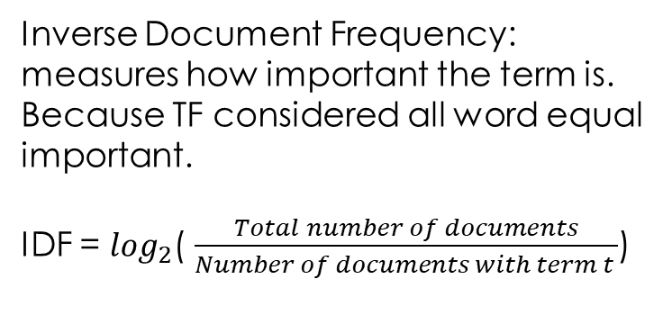

TF – IDF
Term(word) Frequency: measure how frequently a term occur in document
TF = $\frac{Number of times term t appers in document}{Total no of term in document}$
Inverse Document Frequency: measures how important the term is.
Because TF considered all word equal important.
IDF = $\log_{2}$( $\frac{Total number of documents}{Number of documents with term t }$)

Slide 4
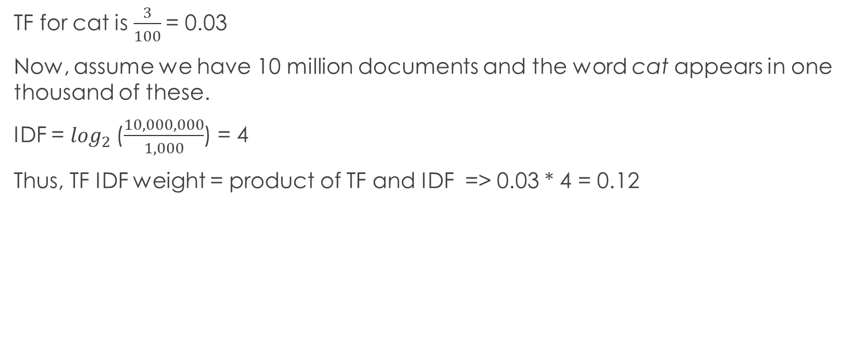
Consider a document containing 100 words where in the word cat appears 3 times.
TF for cat is $\frac{3}{100}$= 0.03
Now, assume we have 10 million documents and the word cat appears in one thousand of these.
IDF = $\log_{2}$($\frac{10,000,000}{1,000}$) = 4
Thus, TF IDF weight = product of TF and IDF => 0.03 * 4 = 0.12

